Slide 1
GROUP 1 - CHECKPOINT 3
MACHINE LEARNING
FOR
DRUG DISCOVERY IN DOPAMINE RECEPTORS
Sravan Kumar Mangalagiri
Rohith Sai Kanchi
Gughapriyaa Elango
Peiyuan Feng

Slide 2
RECAP - Research Question/Hypothesis
Revisiting Data Preprocessing
What are the drugs that are active in inhibiting dopamine receptor protein?
What are their chemical structures/qualities that make them active?
Removing Multicollinearity
Removing Pains Molecules

Slide 3
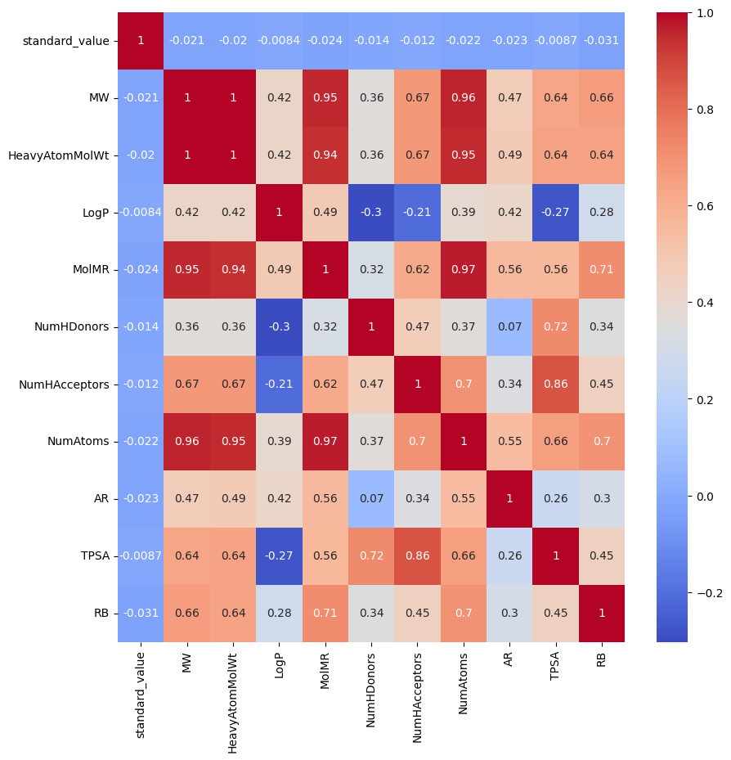
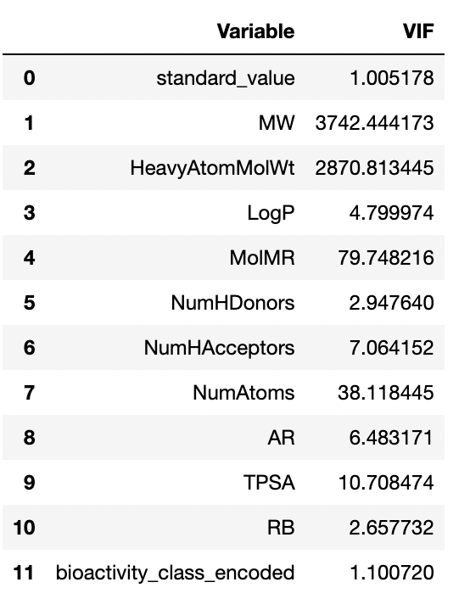
Data Preprocessing - HIGHLY Correlated Features

Slide 4
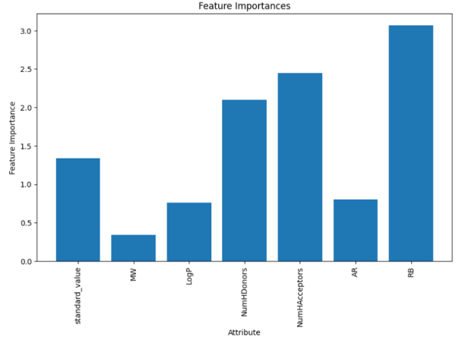
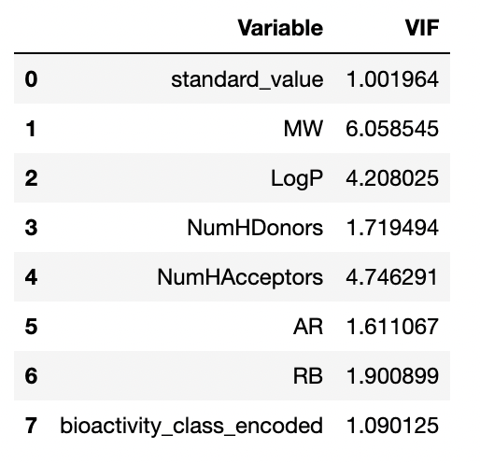
Data Preprocessing - Removing Correlated Features

Slide 5
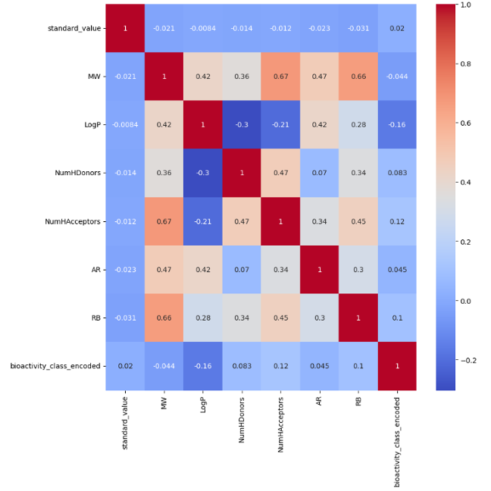
Data Preprocessing - Removing Correlated Features
By combining the correlated features together, and eliminating one variable, correlation between the features have drastically come down.
The heatmap shows the correlation between the different features in the dataset. The darker the color, the stronger the correlation.
The most strongly correlated features are:
NumHDonors and NumHAcceptors: The number of hydrogen bond donors and acceptors are strongly correlated, as expected. This is because hydrogen bonds are typically formed between a hydrogen bond donor and a hydrogen bond acceptor.
LogP and MW: The octanol-water partition coefficient (LogP) and molecular weight (MW) are also strongly correlated. This is because LogP is a measure of how lipophilic a molecule is, and MW is a measure of how large a molecule is. Lipophilic molecules tend to have a higher MW, and vice versa.

Slide 6
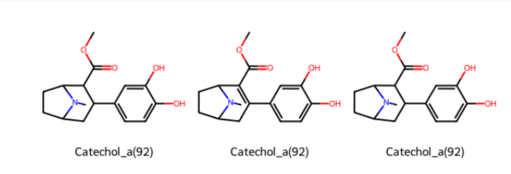
Data Preprocessing - Removing PAINS Molecules
PAINS (Pan-Assay Interference Compounds) are a set of substructures that are commonly found in molecules that interfere with biological assays, but not through specific interaction with the assay target. They often cause false positives in prediction and can lead to erroneous results in drug discovery.
Removing PAINS molecules from a dataset can improve the quality of the dataset by reducing the number of false positives and improving the reliability of the assay results.
ABOUT 125 PAINS MOLECULES WERE REMOVED
VISUALISATION OF PAINS MOLECULES REMOVED:

Slide 7
Prediction Models
The machine learning models tried:
Decision trees
Naive Bayes
K Nearest Neighbours
SVM
Random Forest
Linear Discriminant Analysis
Bagging
XGBoost
K Means Clustering
Hierarchical Agglomerative Clustering

Slide 8
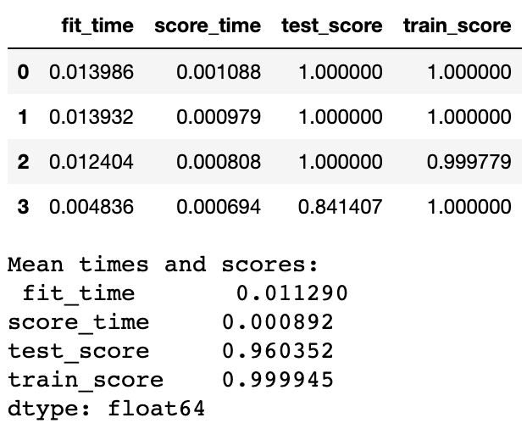
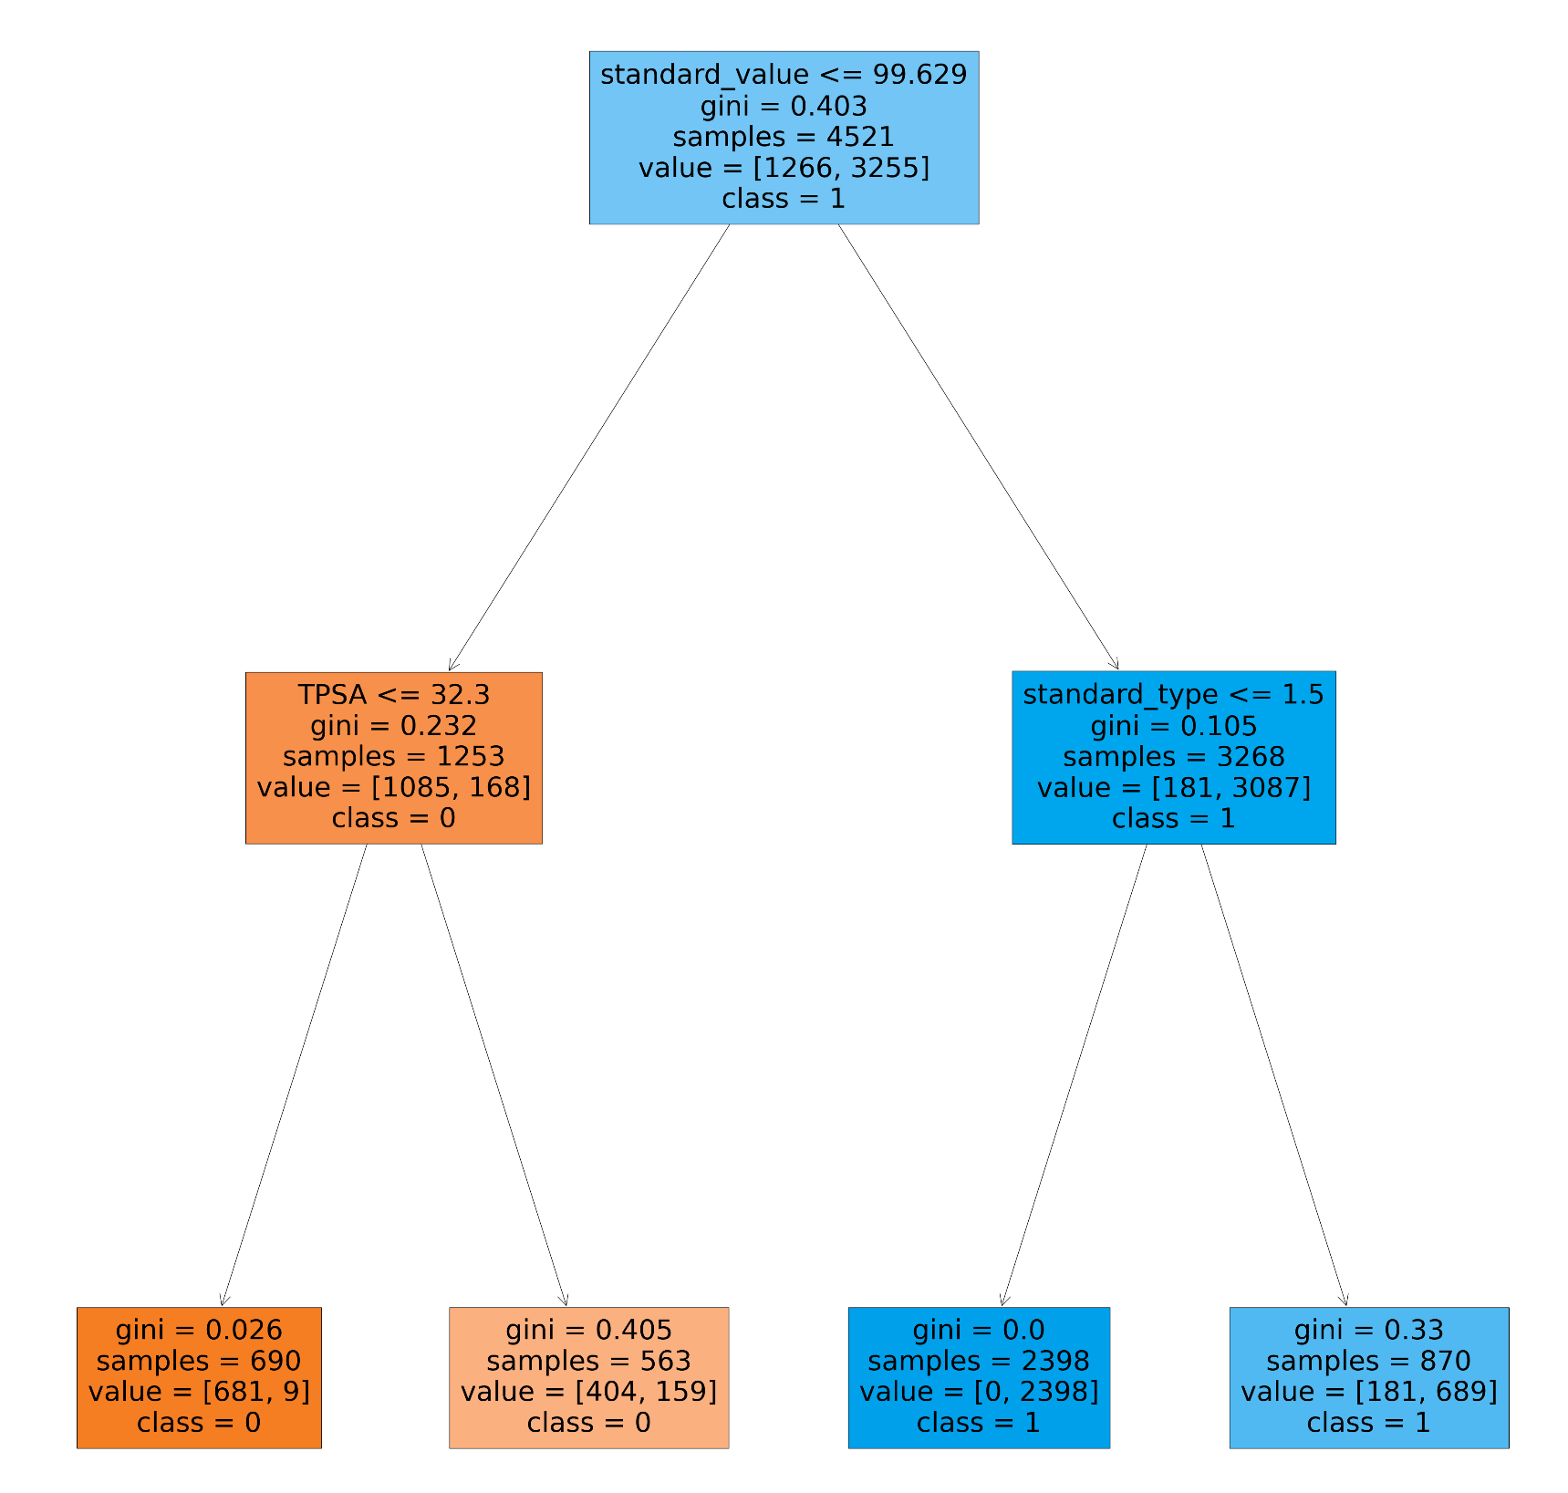
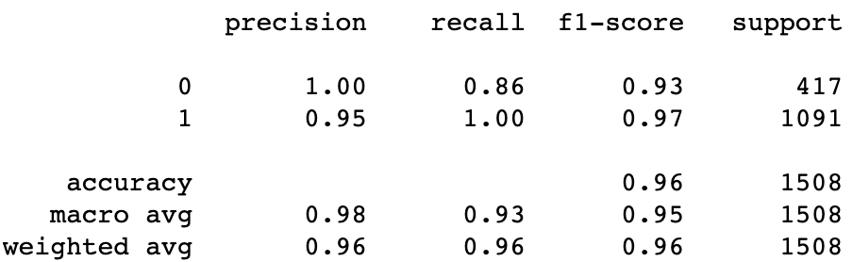
Decision Tree
Confusion matrix:
[[ 360 57]
[ 0 1091]]
The f1 score for the model is 0.96.
Running the decision tree classifier model with max depth of 2, we get a test score of 0.96.

Slide 9
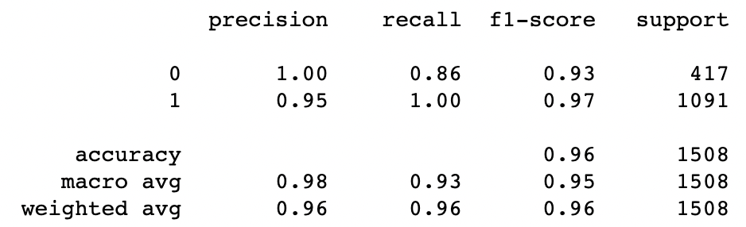
Multinomial Naive Bayes
Accuary: 0.4328726837138806
Metrics after hyperparameter tuning:
Accuracy: 0.4270557029177719
Best parameters: {'alpha': 0.001}
F1 score: 0.3501393463389917
AUC score: 0.6063244729605866

Slide 10
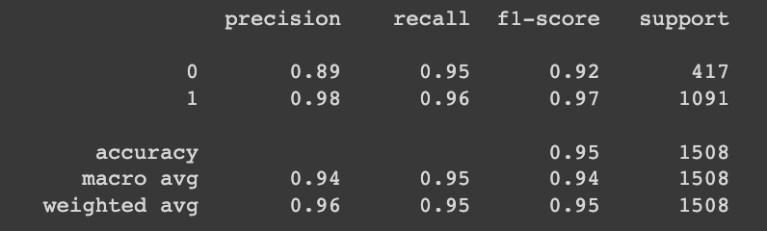
K Nearest Neighbours
Fitting the model to find the best hyperparameters:
Best parameters: {'metric': 'manhattan', 'n_neighbors': 5}
Best cross-validation score: 0.96
accuracy: 0.9542440318302388
F1 score: 0.9680111265646731
AUC score: 0.9852829010851814

Slide 11
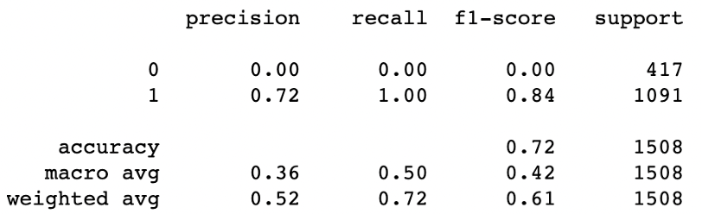
Support Vector Machine
Trying preprocessing techniques with SVM, minmaxscaler was tried to standardize the data. Predicting the test file after running the SVM model with cross validation:
Accuracy: 0.7234748010610079
Average cross-validation score: 0.72
accuracy: 0.7234748010610079
F1 score: 0.8395536744901885
AUC score: 0.5

Slide 12
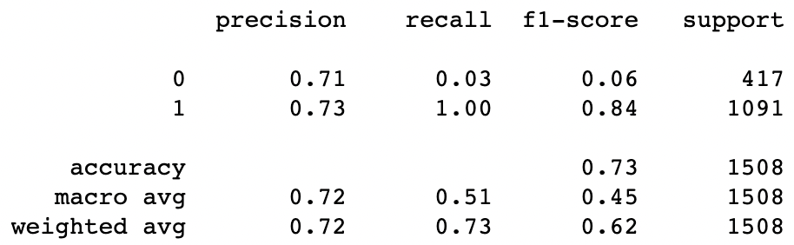
Random Forest
Accuracy: 0.7281167108753316
Average cross-validation score: 0.96
accuracy: 0.7281167108753316
F1 score: 0.8412083656080558
AUC score: 0.5120970134982756

Slide 13
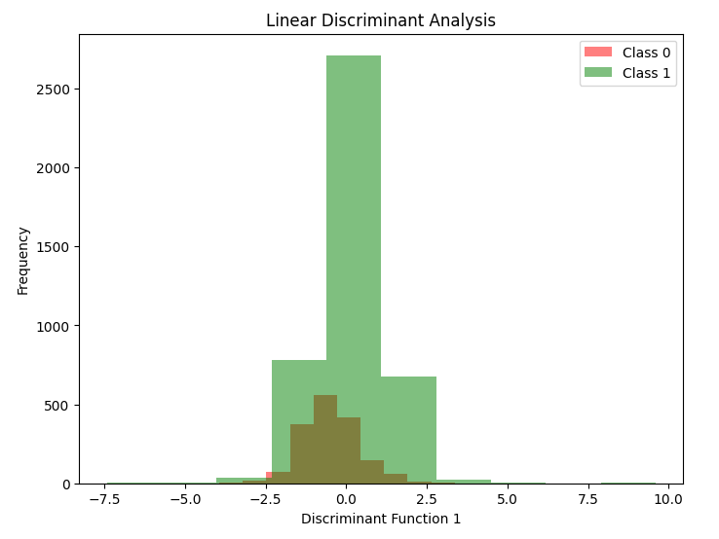

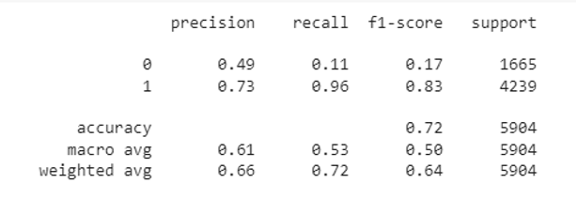
Linear Discriminant Analysis Model
Metrics:
The total accuracy is 0.72 and the total f1 score is 0.83.
Precision for category 0 is 0.49 and for category 1 is 0.73.
Recall for category 0 is 0.11 and for category 1 is 0.96.

Slide 14
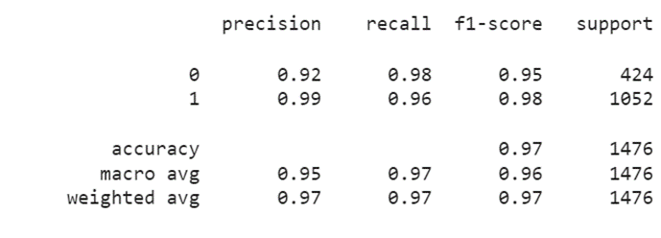
Bagging Model
Trying BaggingClassifier, tuning hyperparameters:
Parameter grid:
{
'n_estimators': [5, 10, 15, 20],
'max_samples': [0.5, 0.7, 0.8, 1.0],
'max_features': [0.5, 0.7, 0.8, 1.0]
}
Best Hyperparameters:
{'max_features': 1.0, 'max_samples': 0.7, 'n_estimators': 10}
Metrics after hyperparameter tuning:
The total accuracy is 0.97 and the total f1 score is 0.97.
Precision for category 0 is 0.92 and for category 1 is 0.99.
Recall for category 0 is 0.98 and for category 1 is 0.96.

Slide 15
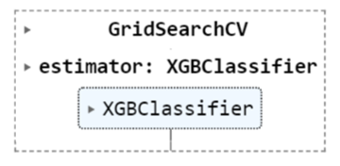
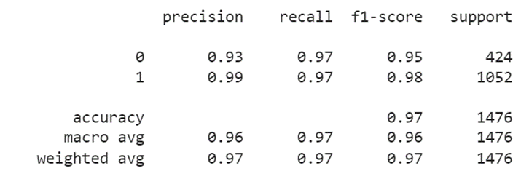
XGBoost Model
Trying XGBClassifier, tuning hyperparameters:
Parameter grid:
{
'max_depth': [3, 5, 7],
'learning_rate': [0.1, 0.01, 0.001],
'n_estimators': [100],
'gamma': [0, 0.1, 0.2],
}
Best Hyperparameters:
{'gamma': 0.1, 'learning_rate': 0.1, 'max_depth': 7, 'n_estimators': 100}
Metrics after hyperparameter tuning:
The total accuracy is 0.97 and the total f1 score is 0.97.
Precision for category 0 is 0.93 and for category 1 is 0.99.
Recall for category 0 is 0.97 and for category 1 is 0.97

Slide 16
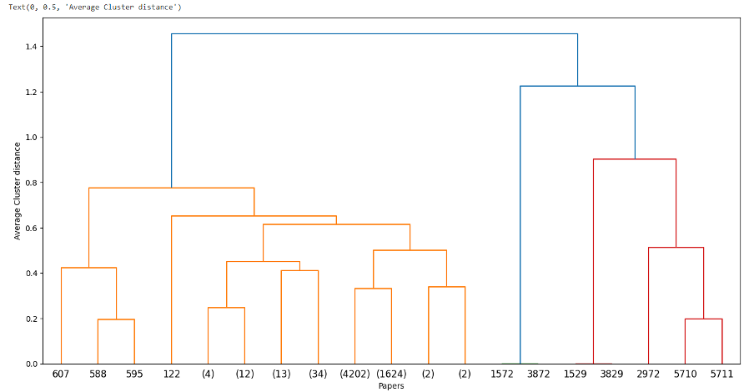
HAC Clustering
Here we dropped the target variable of bio-activity class to try clustering-based analysis

Slide 17
Machine Learning Model Comparisons
 | Parameters tuned | Accuracy | F1 | Precision | Recall
LDA | k=2, alpha=auto,beta=auto | 0.660 | 0.720 | 0.610 | 0.535
Decision tree | Max_depth = 3,min_samples_leaf = 0.01 | 0.96 | 0.96 | 0.975 | 0.90
Naive bayes | alpha=0.001 | 0.42 | 0.35 | 0.60 | 0.21
kNN | Metric = manhattan,n_neighbors=5 | 0.95 | 0.96 | 0.95 | 0.95
SVM | {'C': 0.01, 'kernel': 'linear', 'probability': True} | 0.723 | 0.839 | 0.720 | 0.50
KMeans | n=2,max_iter=100 | 0.590 | 0.405 | 0.500 | 0.500
HAC | n=2,linkage=’average’ | 0.590 | 0.405 | 0.500 | 0.500
Random Forest | C': 0.01, 'kernel': 'linear', 'probability': True | 0.730 | 0.640 | 0.720 | 0.650
Bagging | 'max_features': 1.0, 'max_samples': 0.7, 'n_estimators': 10 | 0.970 | 0.970 | 0.955 | 0.970
XGBoost | 'gamma': 0.1, 'learning_rate': 0.1, 'max_depth': 7, 'n_estimators': 100 | 0.970 | 0.970 | 0.960 | 0.970

Slide 18
Most Important Metrics in Drug Discovery
Precision
Precision is the proportion of true positives out of the total predicted positives. It indicates the model's ability to correctly identify true drug candidates among the predicted positive samples. High precision means that the model is less likely to produce false positives, which can reduce the risk of wasting resources on non-promising drug candidates, and testing the unnecessary drugs on humans.
Recall
On the other hand, recall is the proportion of true positives out of the total actual positives. It is a measure of the model's ability to correctly identify all the positive samples, including true drug candidates. High recall means that the model is less likely to miss true drug candidates which can be important in ensuring that potential drug candidates are not overlooked.

Slide 19
Neural Network Models to predict Bioactivity Class
Neural Networks are potent machine learning models that can effectively model the intricate relationships between the input variables and the objective variable. In the case of predicting the Bioactivity class, a large number of variables are likely to contribute to the classification, making it difficult to identify the most significant variables and their interactions. Neural Networks are capable of autonomously identifying and capturing these nonlinear relationships.
In bioactivity prediction, where there are thousands of compounds and numerous molecular descriptors for each compound, Neural Networks have demonstrated their ability to effectively manage large volumes of data. Neural Networks are a viable option for predicting the Bioactivity class due to their capacity to manage large quantities of data and recognize complex relationships.
TYPES OF MODELS TRIED:
ANN - ARTIFICIAL NEURAL NETWORK
CNN - CONVOLUTIONAL NEURAL NETWORK
RNN - RECURRENT NEURAL NETWORK

Slide 20

Artificial Neural Network (ANN)
Artificial Neural Network (ANN). A brain-inspired machine learning algorithm. Each node conducts a mathematical operation on its inputs and passes the output to the next tier.
Based on Lipinski descriptors, an ANN may estimate the bioactivity class of a molecule using the available data. The ANN can predict compound classes in the test set by training on a subset of data with known bioactivity classes. The ANN recognizes patterns in input data and generates a probability distribution for each class.

Slide 21
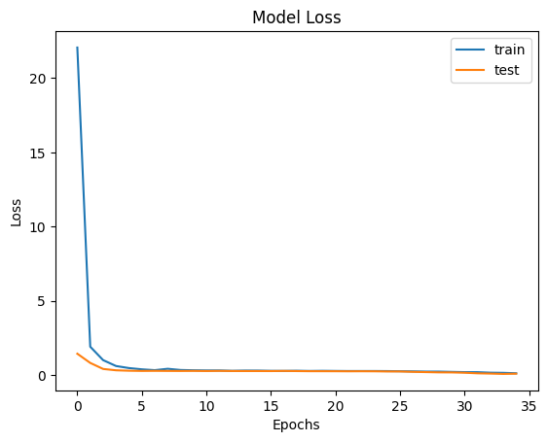
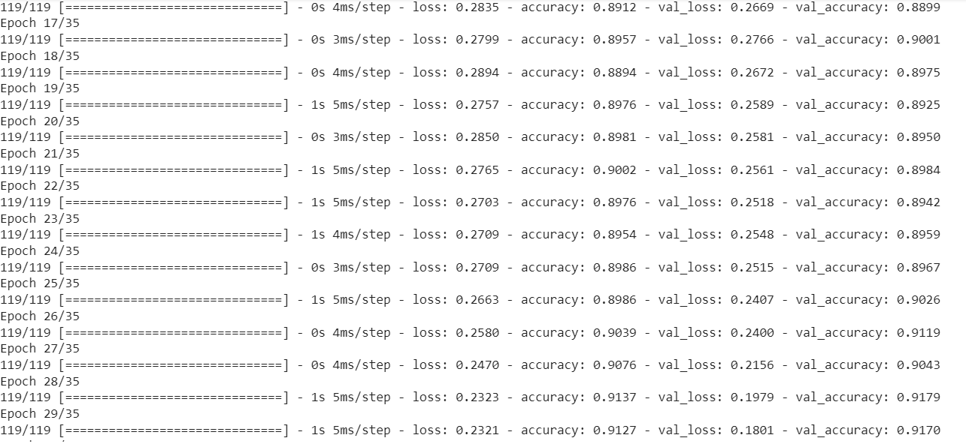
ANN
epochs=35

Slide 22
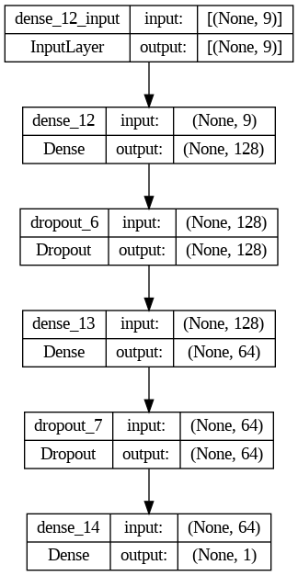
ANN
ANNs are fully connected and make no data structure assumptions, unlike CNNs and RNNs.
This ANN architecture uses a rectified linear unit (ReLU) activation function and consists of a 9-node input layer followed by two 128-node hidden layers. For binary classification, the output layer just contains a single node with a sigmoid activation function.
The loss function in this model is binary cross-entropy, and the batch size is 32. During backpropagation, the weights are updated using the Adam optimizer and a learning rate of 0.001.
In the ANN architecture, dropout is implemented after the first and second hidden layers with a dropout rate of 0.25. Early stopping is also implemented using a validation set, where training stops when the validation loss does not decrease for five epochs. These techniques help prevent overfitting and improve the generalization performance of the network.

Slide 23
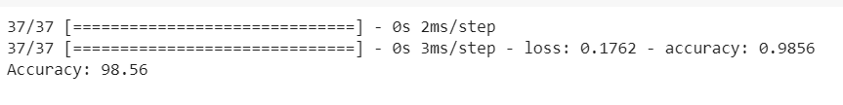
Convolution Neural Network - CNN
Deep learning algorithm CNN processes images and signals. Convolutional and pooling layers recognize patterns and features in pictures and signals. The convolutional layers filter each input image to create a feature map that highlights particular features. Pooling layers then minimize feature map size by taking the maximum or average value of a group of pixels. This reduces noise and improves calculation.

Slide 24
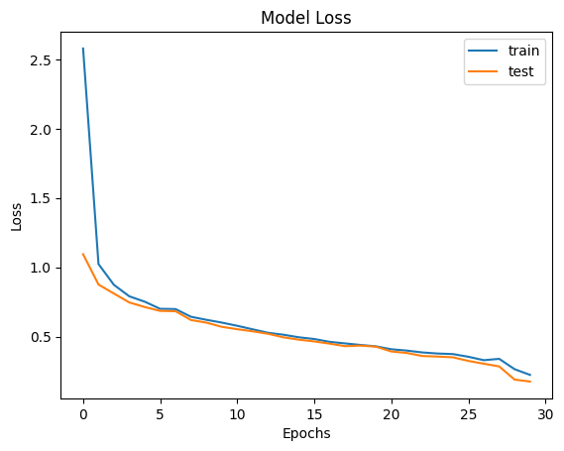
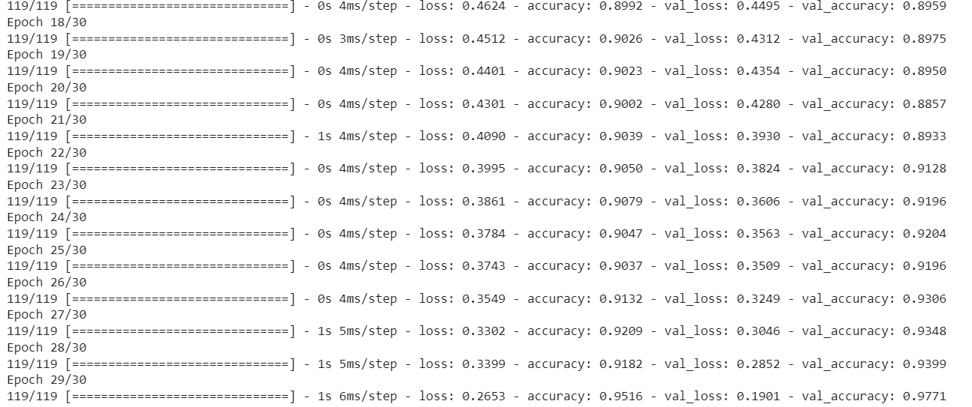
CNN

Slide 25
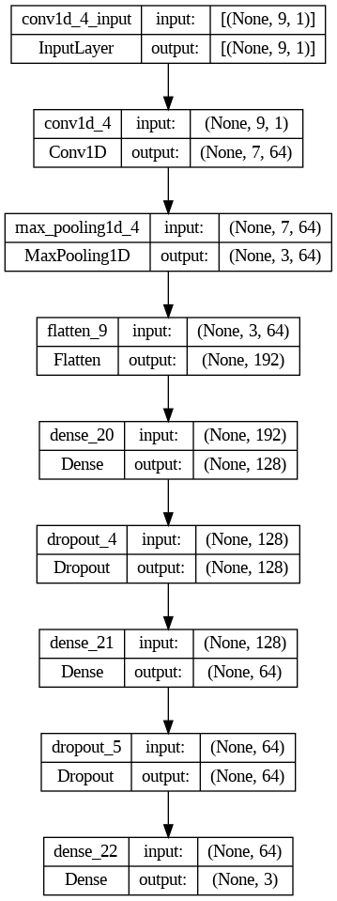
CNN
Padding, stride, and many layers with distinct activation functions are all features of the CNN design. The activation function of ReLU is used in the input layer, whereas the activation function of Softmax is used in the output layer. The stride and filter sizes vary across the convolutional layers. The max pooling layers shrink the feature maps to a more manageable size. Classification is performed on the dense layers with dropout regularization to prevent overfitting. In conclusion, the model employs the Adam optimizer and the loss function of categorical cross entropy.

Slide 26
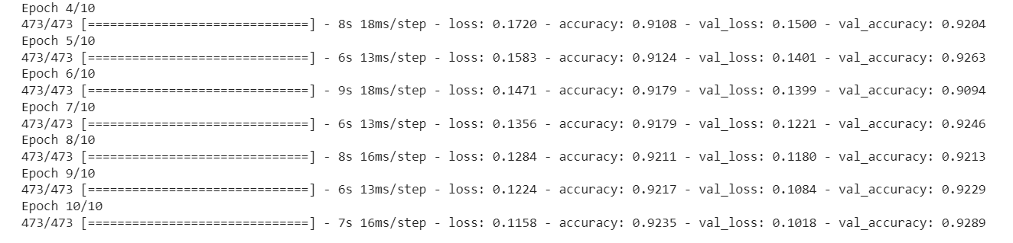
Recurrent Neural Network - RNN + BiLSTM
Recurrent neural networks (RNNs) can process variable-length sequential data and output related outputs. RNNs process sequential data like time-series, natural language processing, speech recognition, and music composition.
RNN can assess the dataset's consecutive molecules. RNN can forecast a molecule's bioactivity class based on its chemical structure and its predecessors' bioactivity levels. Drug discovery and lead optimization employ this to find new molecules with high bioactivity based on known chemicals. Sequence-to-sequence mapping uses RNN to create a series of structurally similar molecules.

Slide 27
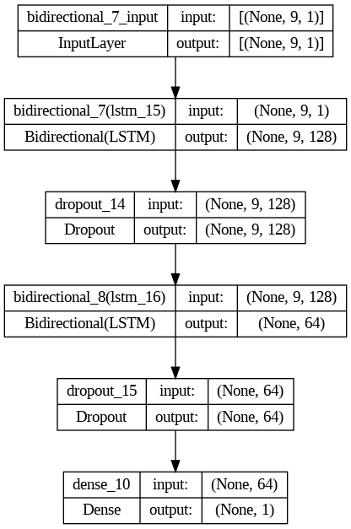
RNN + BiLSTM
An embedding layer receives the input sequence and uses it to learn a very detailed representation of the input language.
A 128-unit, single-layer RNN with the Tanh activation function is fed the embedded sequence. The RNN layer generates a stream of unobservable states.
The output of the RNN is fully connected and uses the ReLU activation function on its 64 units.
In the end, a Sigmoid activation function is applied to a single output unit coupled to the fully connected layer to get a binary classification.

Slide 28
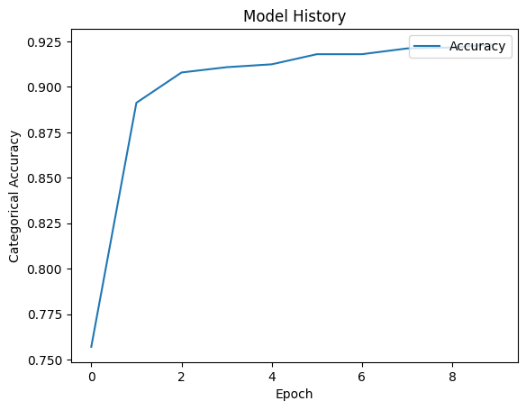
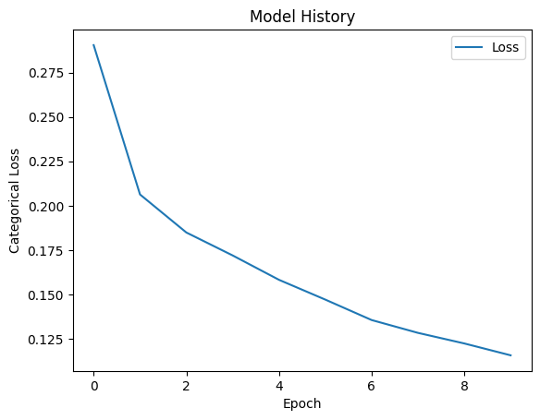
RNN + BiLSTM
The depicted RNN architecture can be enhanced by incorporating techniques such as Bidirectional LSTM to capture past and future context, Dropout to prevent overfitting, and Early stopping to monitor validation loss and cease training when validation loss stops improving. Adding a Bidirectional LSTM layer before or after the existing LSTM layers, Dropout layers after each LSTM layer, and the EarlyStopping callback in Keras can help the RNN architecture to better understand the sequence, prevent overfitting, and improve generalization performance by stopping the training process when the validation loss stops improving.

Slide 29
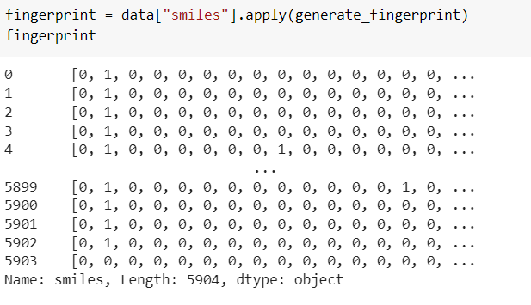
Neural Network Model to Predict Chemical Fingerprints
USING MORGAN FINGERPRINT AND CNN:
Morgan fingerprints are a type of molecular fingerprint that encode the topology of a molecule using circular fingerprints. They are commonly used in cheminformatics and machine learning applications to represent molecules and compare their similarity. Morgan fingerprint is a binary vector that encodes the presence or absence of each circular substructure in the molecule, and its length depends on the chosen fingerprint radius and bit length.

Slide 30
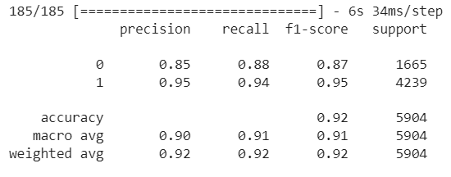
Morgan Fingerprint and CNN
185/185 [==============================] - 4s 22ms/step - loss: 0.2155 - accuracy: 0.9231
Test accuracy: 0.9231029748916626

Slide 31
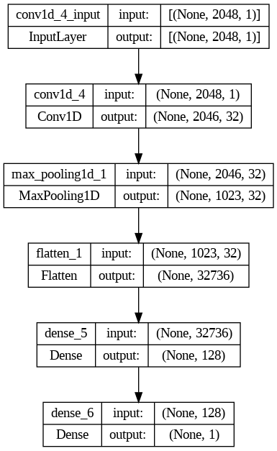
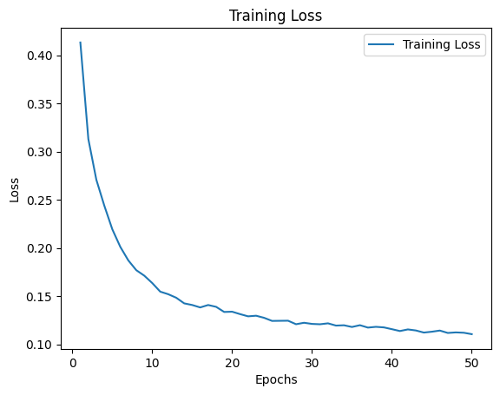
Morgan Fingerprint and CNN

Slide 32
Atom Tokenization and RNN
ATOM TOKENIZATION:
From the chemical canonical SMILES, we are tokenizing them into respective atoms using SmilesPE package.
SmilesPE is a tokenizer designed specifically for chemical structures encoded in the Simplified Molecular Input Line Entry System (SMILES) notation. It is a byte pair encoding (BPE) tokenizer that uses a vocabulary of SMILES-specific tokens to split SMILES strings into subtokens.
When SmilesPE.tokenizer processes a SMILES string, it first converts the string into a sequence of characters. It then iteratively replaces pairs of characters with new tokens from the vocabulary, based on the frequency of the pairs in the input data. This process continues until the maximum vocabulary size is reached or no more frequent pairs are found.

Slide 33
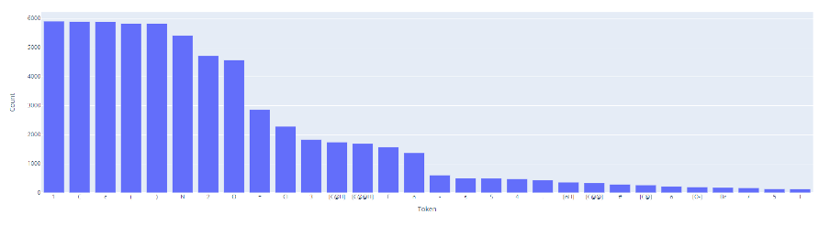
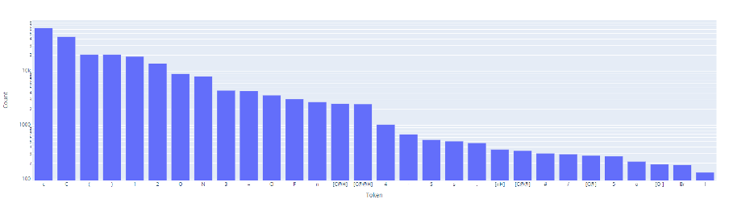
Atom Tokenization and RNN
Token frequency of tokens that appears once:
Token frequency of all tokens:

Slide 34
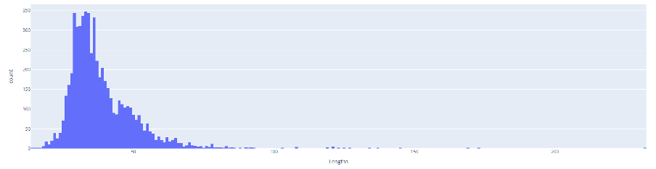
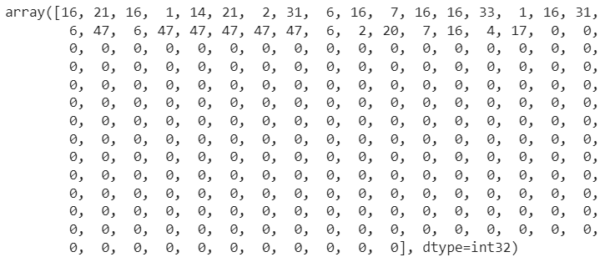
Atom Tokenization and RNN
Histogram of length of the chemical fingerprint sequence:
Example final padded sequence of a compound:

Slide 35
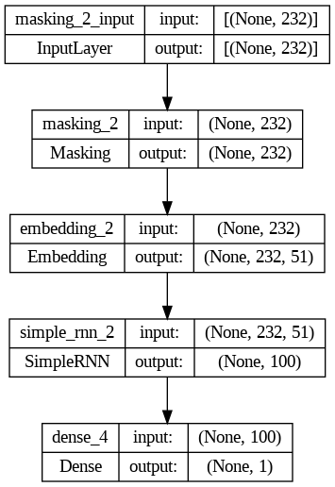
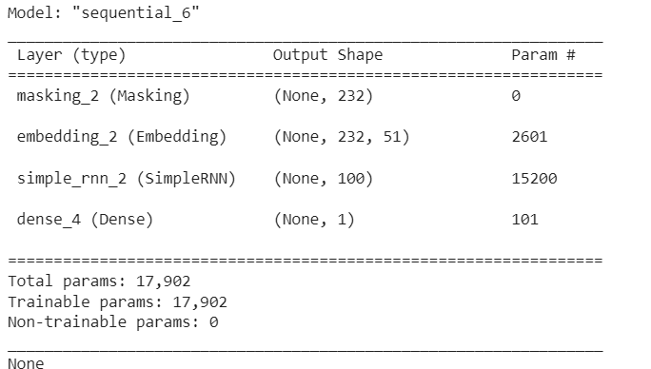

Simple RNN as Baseline
Confusion Matrix

Slide 36
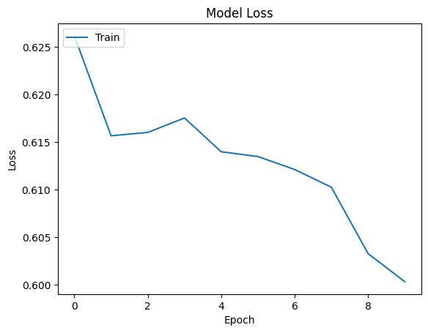
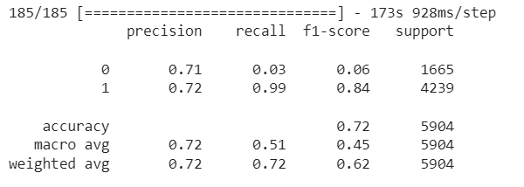
Simple RNN as Baseline
Plotting Training Loss:
Metrics:

Slide 37
Conclusion
Using machine learning and neural network models, were were able to predict the bioactivity classes of chemical compounds and their chemical structures useful in inhibiting dopamine receptors. Among machine learning models, ensemble models worked well in predicting, and in neural networks, RNN models performed the best. In predicting chemical fingerprints, RNNs with Bi-LSTM achieved about 72% accuracy.

